Slide 1

StuffMyFiles.cf
A Cloud Drive built by Abdulsalam Bdeir, Kevin Tran, Jae Park, William Rood

Slide 2


Purpose of StuffMyFiles
File hosting service
Anonymity
Store/alter/download/delete files
Choose file permissions
Add friends

Slide 3



Goals of our Project
Setup a server for hosting the website, storing/managing user data
Develop a user interface
Setup operations such as uploading/downloading files, logging in/out, creating an account, searching for contacts, adding contacts, and sharing files
Make visually appealing

Slide 4

Server Setup

Slide 5

Server Setup
The Server is constructed on an old macbook that is no longer used.
The website is hosted from a home network to the internet without the help of any third party companies besides the one used for the domain name.
The project was created in a LEMP stack
LEMP stack includes:
Linux OS
Web Server
Database Server
Dynamic Processor

Slide 6

Installing the LEMP stack software

Slide 7


Nginx
Nginx is an open-source HTTP server and reverse proxy.
A newer web server platform built as an improvement to Apache valuing performance and stability.
Supports all components of modern sites: WebSocket, HTTP/2, gRPC
Also acts as a load balancer and web accelerator throughout different web pages.

Slide 8
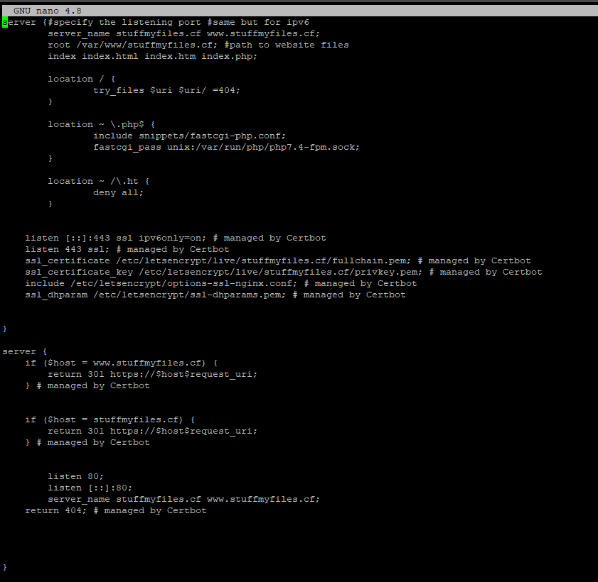
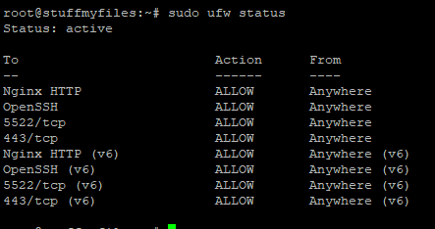
These are the different visible elements of Nginx. Includes the firewall status and the server information

Slide 9

MySQL
Open-source relational database management system.
Allows for managing users, storage of computer systems, network access, etc.
Works well with PHP and other web languages

Slide 10
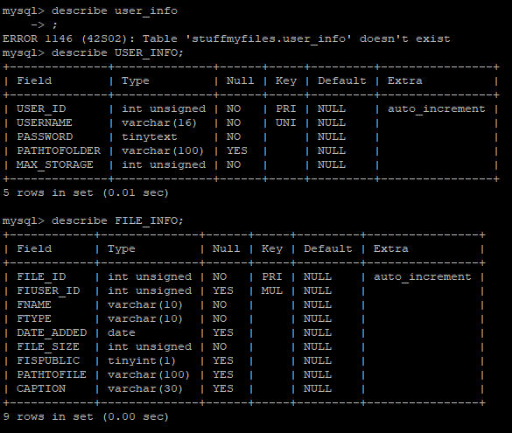

Slide 11
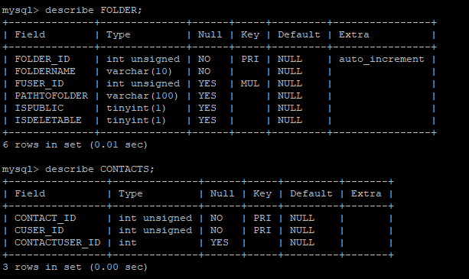

Slide 12


PHP
An open-source scripting language for web development
Used for creating needed operations
A combination of PHP and HTML were used to develop this software

Slide 13
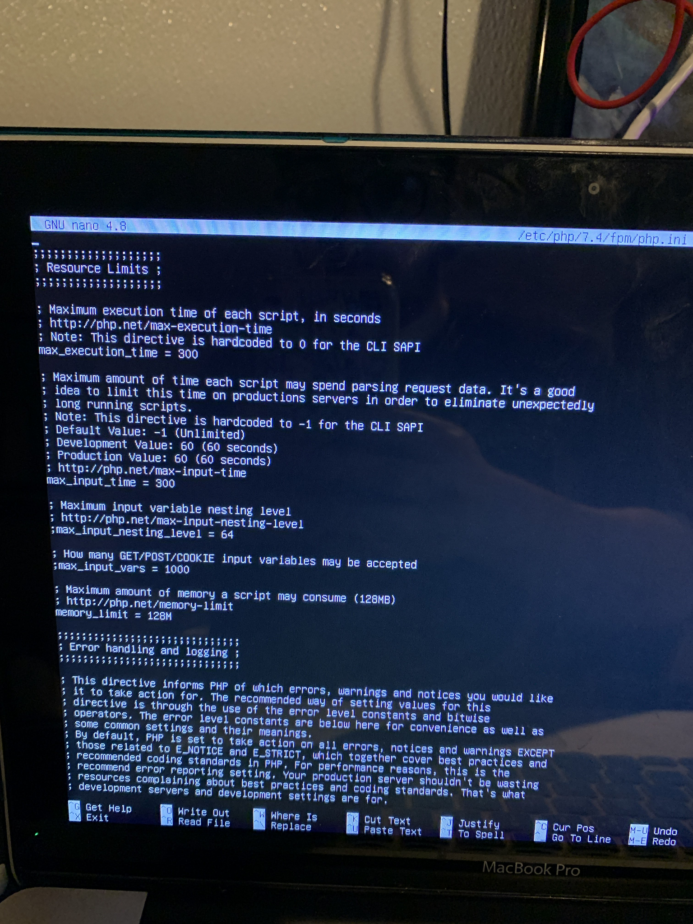
This is where you can view the resource limits and error handling, among others that PHP offers in linux

Slide 14
Additional Website Setup
Set up host machine firewall settings to accept for port 443 and 80 (HTTPS and HTTP)
Obtained the domain name “Stuffmyfiles.cf”
Altered the DNS management settings → Type A forwarded to Router’s Public IP Address
Port forwarding was set up in router to point incoming connections for port 80 and port 443 to my webserver
TLS Certificate was installed on the host machine for HTTPS encryption

Slide 15

The User Interface

Slide 16
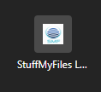
Account Registration
Registration is Setup by:
New user is directed to a registration page
User will enter in a username and password
The username and password are added to SQL database
The user can then login after successfully creating an account
The user is then given the ability to view their folder on the homepage and upload/download files of their choice

Slide 17
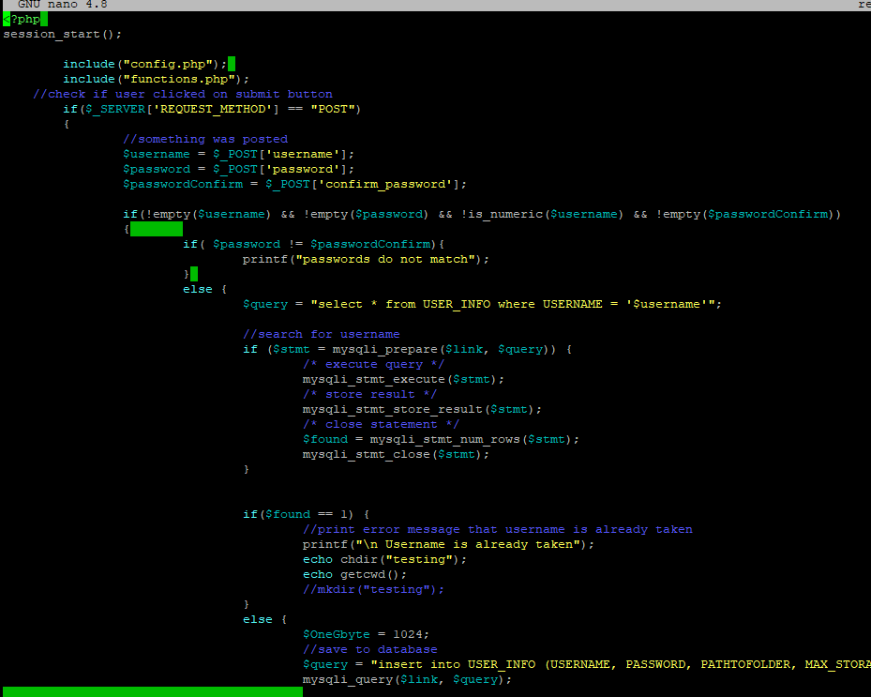
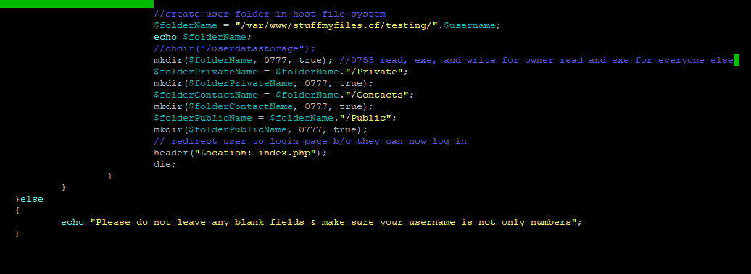
Register.php

Slide 18
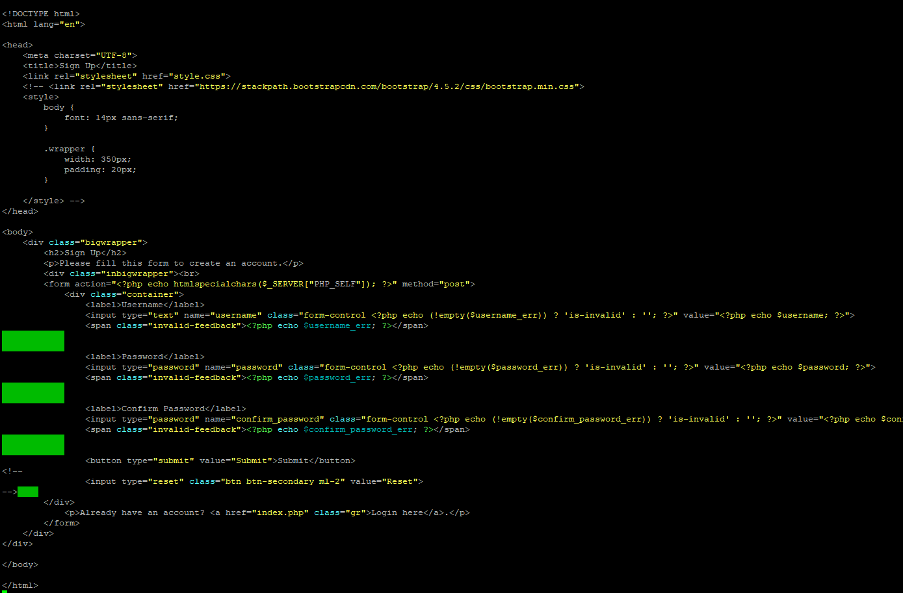

Slide 19
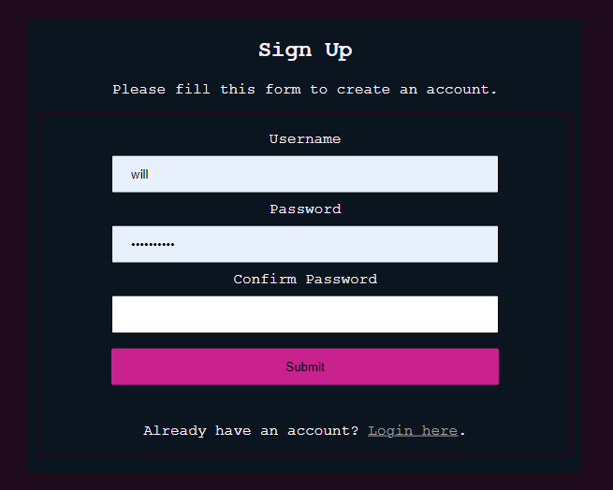

Slide 20
Login Page
When user opens the site, they are immediately moved to the login page
The main page will consist of a box that has the user to type in username and password
Login:
-User enters the username and password
-When the login button is pressed the website checks SQL
database if the username and password exists
-Successfully logs in if the username and password exists

Slide 21
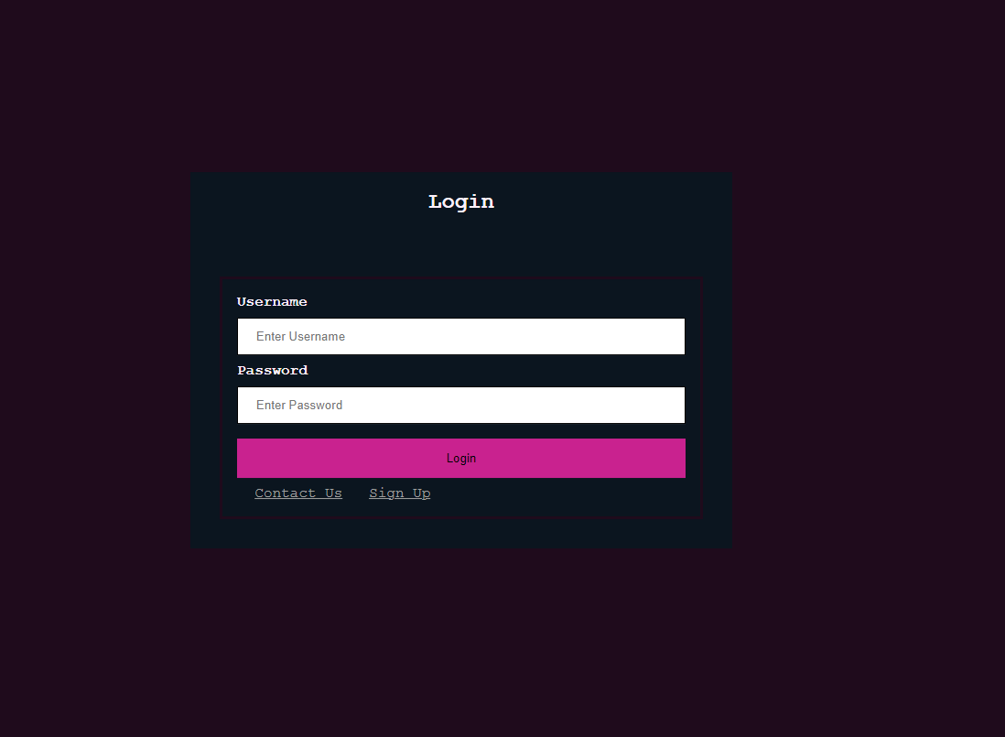

Slide 22
Elements of the Login Page
User Session: A way to check if the user is signed in or not
Prevents users from accessing the homepage without signing in
The cookie that checks the activity of the user
If not logged in, redirects user to login screen. If logged in, redirects to home screen

Slide 23
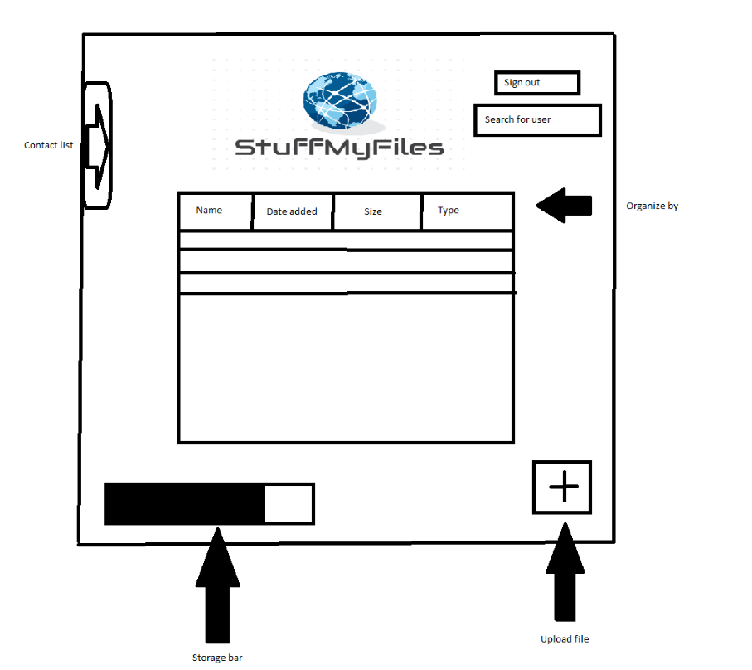

Slide 24
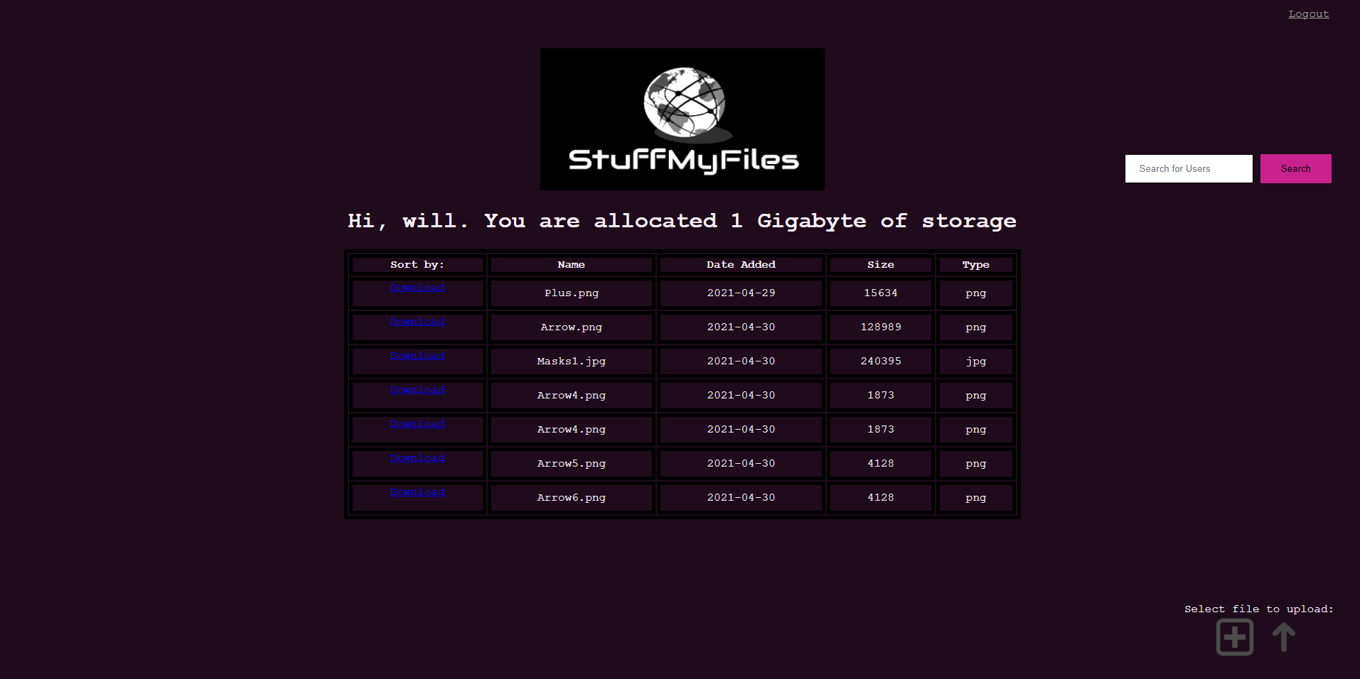

Slide 25

Front-end Functions for the Home Page
Functions:
Upload, Download, Logout
Uploads a file to the system, will prompt the user to upload a file on their computer
Downloads a file
Logs the user out of the website
Edit: Sort by Name, Date, Size, Type
Contact Search
Sends a query to the database and returns results if there exists a username that matches the text from the search bar
View uploaded files and associated attributes
Uses MySQL database to receive information about uploaded files and uses said information to display on the home screen

Slide 26
Back-end Functions of the Cloud Drive
Config.php: Checks to see if the user is logged in and secures a connection to the MySQL database
Index.php: Allows a user to log in if they put in the correct credentials
Welcome.php: The home screen of the website once the user logs in. Users have the ability to upload files, view their uploaded files, and download files
Download.php: Takes the filename as an argument, checks the user session variable to check which user has requested the download function and then gives the user a prompt to download the file they have selected onto their computer
Register.php: Creates an instance of a user in the database using the fields given in the text boxes, only if an instance with the inputted username already exists

Slide 27
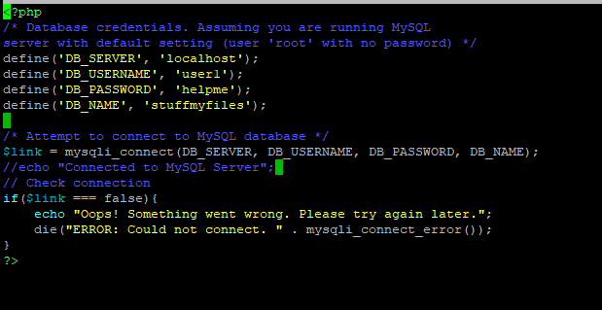
Config.php

Slide 28
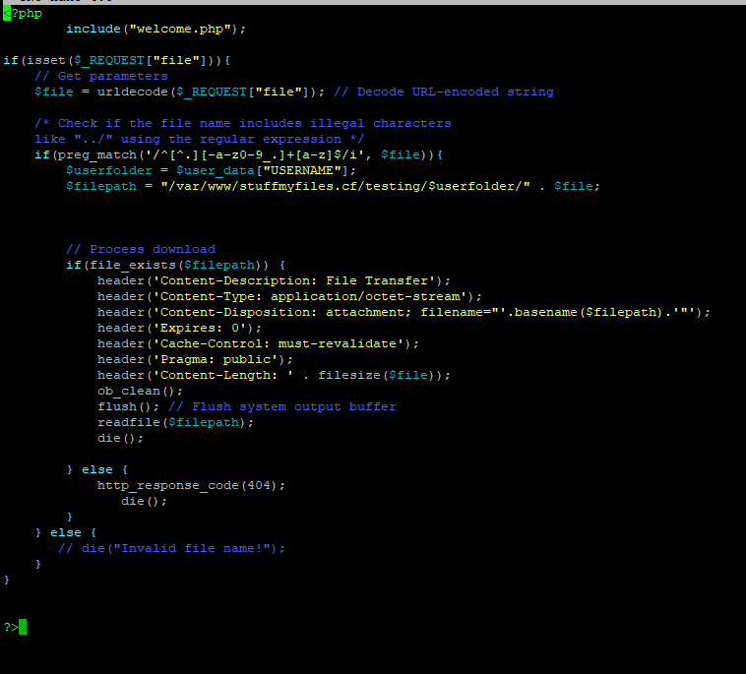
Download.php

Slide 29
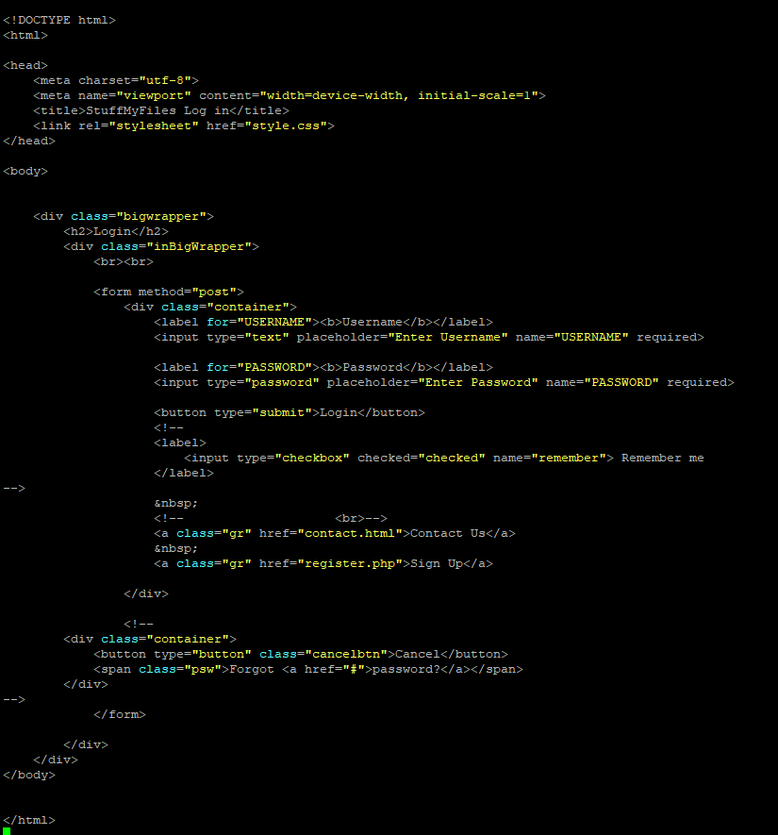
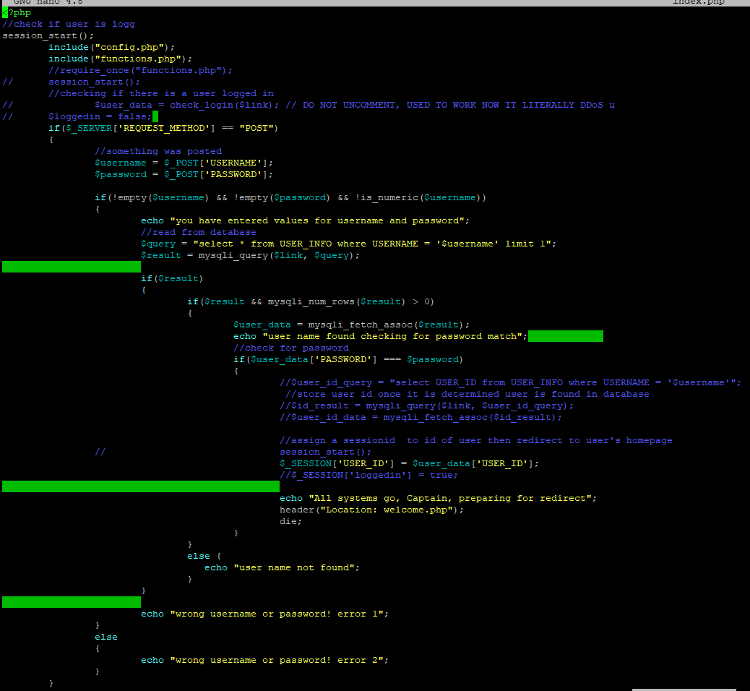
Index.php

Slide 30
Process of Coding

Slide 31
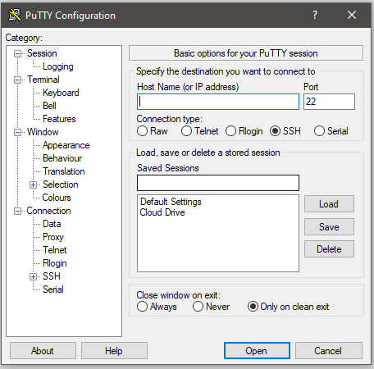
To connect to the host server from our own devices, we needed to use a program called PuTTY. This allowed us to all work simultaneously on the linux terminal.

Slide 32
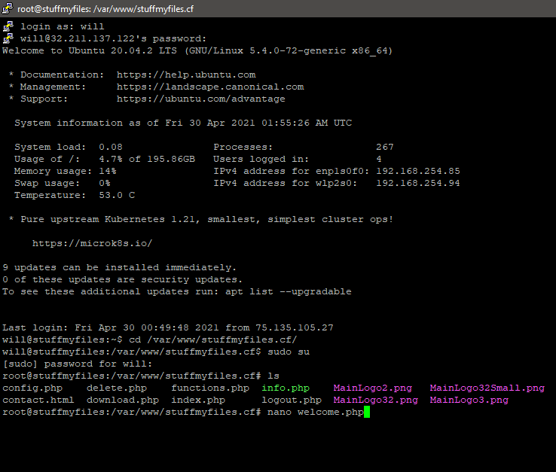
How we had to initiate our session when coding in the linux terminal. Commands such as:
Cd /var/www/stuffmyfiles.cf/ -- this would allow us to change directories
Sudo su -- gain root privileges to edit files
cat>filename.php -- to create files in the appropriate directory
Nano filename.php -- this was to get inside of a file and edit the contents
Ls -- this command displays all of the files within a certain directory
Mv -- used to move files to different directories
Rm -- used to remove files

Slide 33

Other Information

Slide 34

Setbacks of the Design Process
There was an initial problem with trying to connect to wifi with the Host computer
Lack of knowledge of PHP, Linux terminal, and HTML led to many problems when creating code for the website
Only 1 person was able to edit a program at any given time. If 2 or more people were to edit the same program at the same time, it would cause problems regarding saving permissions
Issues arose when trying to store files on the external hard drive within the server laptop
Notes:
The DHCP client wouldn’t assign an IP address to the machine. Had to write a WPA supplicant AND set up a netplan. Now it works but every time the computer loads I need to run the WPA supplicant

Slide 35
Citations/Resources
https://www.digitalocean.com/community/tutorials/initial-server-setup-with-ubuntu-20-04
https://www.digitalocean.com/community/tutorials/how-to-install-linux-nginx-mysql-php-lemp-stack-on-ubuntu-20-04
https://docs.digitalocean.com/products/networking/dns/
https://www.digitalocean.com/community/tutorials/how-to-point-to-digitalocean-nameservers-from-common-domain-registrars
https://www.serverlab.ca/tutorials/linux/web-servers-linux/how-to-configure-multiple-domains-with-nginx-on-ubuntu/
https://artisansweb.net/create-php-login-system-your-website/
Login And Registration System Using PHP And MySQL https://www.youtube.com/watch?v=pYVMQBwPJn8
https://www.w3schools.com/howto/howto_css_login_form.asp
https://phoenixnap.com/kb/ssh-to-connect-to-remote-server-linux-or-windows

